Slide 1

Matoshri College Of Engineering And Research Centre,Eklahare
Project Topics
Language Translator with ML.
MNC Job Notifier.
Crime Prevention Surveillance with Technology.
Project Guide : Ms.S.H.Adke

Slide 2

Language Translators
with ML
Explore the world of language translators, unlocking global communication.

Slide 3

The Role of Machine Learning in Language Translation
1
Data Collection
Gathering multilingual text for model training
2
Model Training
Leveraging neural networks to learn translation patterns
3
Real-time Translation
Applying ML models to provide instant language conversion

Slide 4

Challenges
1
Data Availability
Accessing high-quality, diverse training datasets
2
Model Complexity
Designing robust neural networks for translation
3
Language Nuances
Capturing contextual and cultural differences
4
Computational Resources
Ensuring scalable, real-time translation performance

Slide 5




Django Framework for Building Language Translation Apps
Web Development
Data Modeling
API Integration
Scalability
Leverage Django's MVC architecture
Manage multilingual content and user data
Connect to translation service APIs
Deploy highly scalable translation apps

Slide 6




Artificial Intelligence and Language Translation
Neural Networks
Natural Language Processing
Machine Learning
Advanced models for contextual translation
Continuous model improvement through training
Understand language structure and semantics

Slide 7
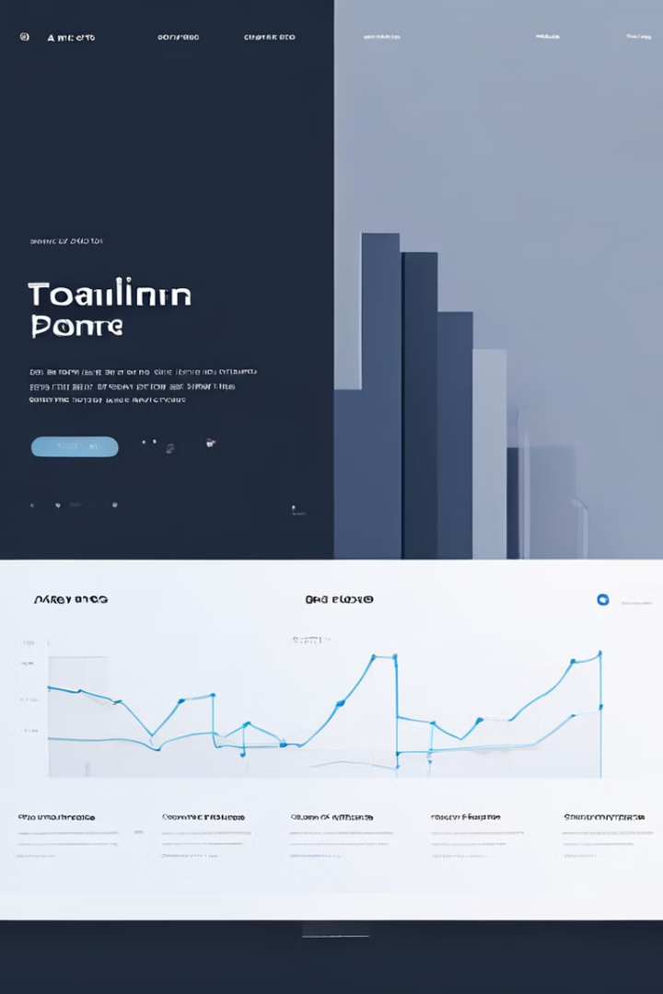
Technology
Machine Learning
Leverage advanced neural networks for translation
Python
Leverage powerful NLP libraries and frameworks
Django
Build scalable, feature-rich translation web apps

Slide 8
Applications
Multilingual Chat
Document Translation
Travel Assistants
Enabling real-time translation for global teams
Automating the translation of legal, medical, and business files
Providing instant translation for tourists and travelers

